Slide 1
Continuous Deliver and Mircoservices
Building and Deploying Cloud Native Apps

Slide 2

CLOUD NATIVE
Agile
Lean
Continuous
Delivery
Microservices
Cloud
DevOps

Slide 3

“Software is Eating the World”
Notes:
You’ve probably seen this slide before…but it’s worth revisiting
Stable industries that have had entrenched leaders are rapidly being disrupted, and they’re being disrupted by businesses with software at their core.

Slide 4



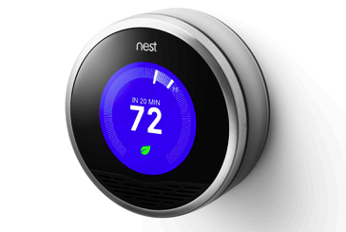


Is There a Pattern?
$3.5B valuation
Financial Services
$3.5B valuation
Transportation
$20B valuation
Entertainment
$3.5B valuation
Travel & Hospitality
$3.2B Acquisition by Google
Home Automation
$26B valuation
Tesla - Automotive
Notes:
Here’s a few of those industries…

Slide 5

SPEED

Slide 6

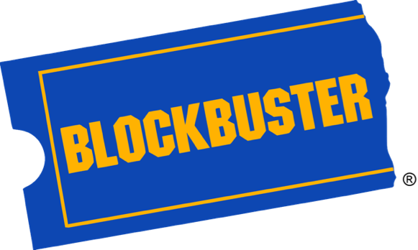
A Tale of Two Companies

Slide 7
SAFETY

Slide 8
Safety?
Visibility
Fault Isolation
Fault Tolerance
Automated Recovery

Slide 9
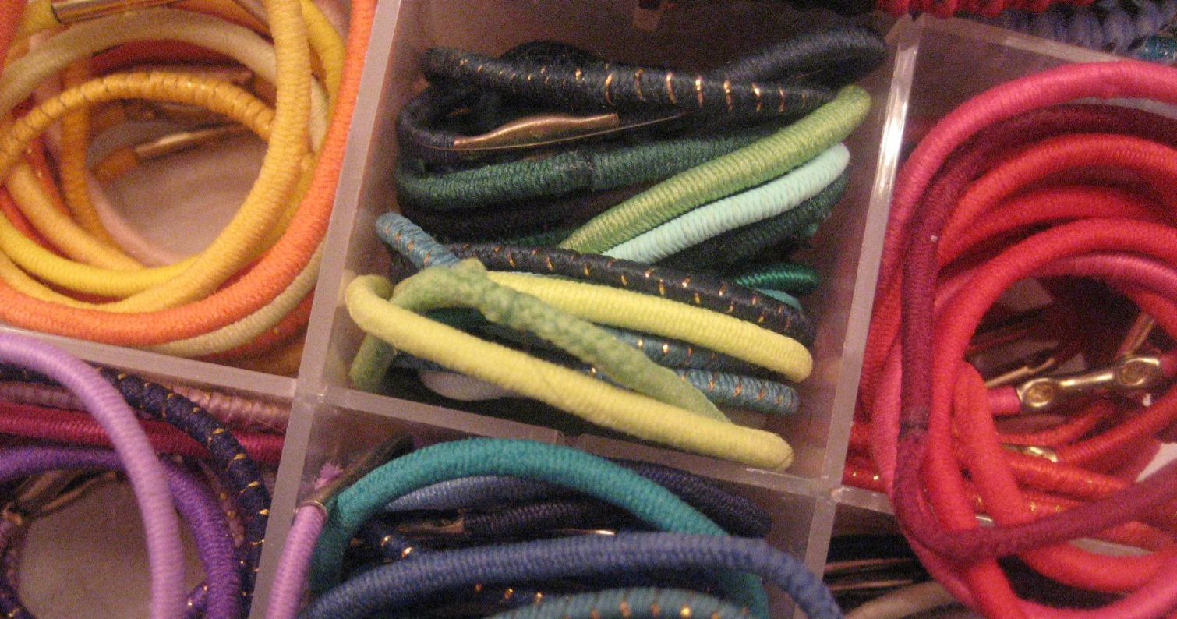
SCALE

Slide 10
Horizontal Scale
Slow/Expensive
Fast/Cheap
Notes:
Scaling used to be accomplished vertically…very slow (must minimally reconfigure/reboot virtual machines or physically reconfigure racked hardware) and expensive.
The big players (google, facebook, netflix, etc.) accomplish scale via horizontal scale on commodity hardware. Usually via containers/lightweight VMs.

Slide 11
But what is
Cloud-Native Architecture?

Slide 12
DEFINE: Micro Service
If every service has to be updated in concert, it’s not loosely coupled!
Loosely coupled service oriented architecture with bounded contexts
If you have to know about surrounding services you don’t have a bounded context.
Notes:
Often rest/http, lightweight container
Domain Driven Design applied in a new way
http://martinfowler.com/articles/microservices.html#AreMicroservicesTheFuture
http://highscalability.com/blog/2014/4/8/microservices-not-a-free-lunch.html

Slide 13
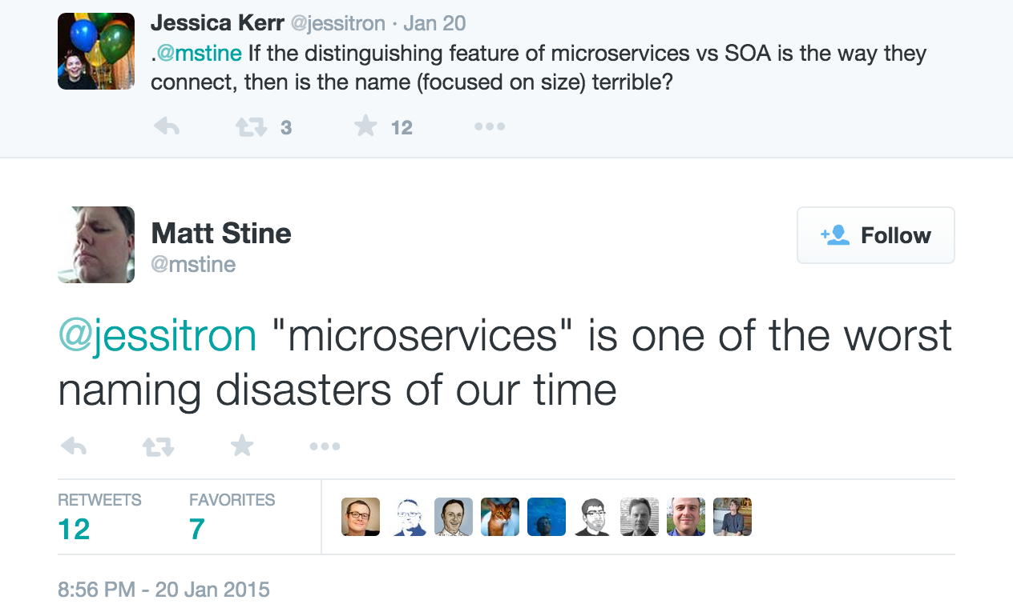
https://twitter.com/mstine/status/557763539101032448
Notes:
Qualitative (focus, role, capability) vs. Quantitative (lines, operations, endpoints)

Slide 14


Not Monoliths
HTML
JavaScript
MVC
Service
Service
Data Access
Browser
Monolithic Application
Relational Database
Notes:
Of course none of this is true in the traditional monolith

Slide 15
Not Traditional (ESB-centric) SOA
UI
Service
Service
Service
Service
UI
Enterprise Service Bus
Service
Service
Service
Service
Notes:
Nor is it true here either…
Essentially trading one monolith for another
Trying to hide essential complexity behind accidental complexity…shoving it into a box

Slide 16
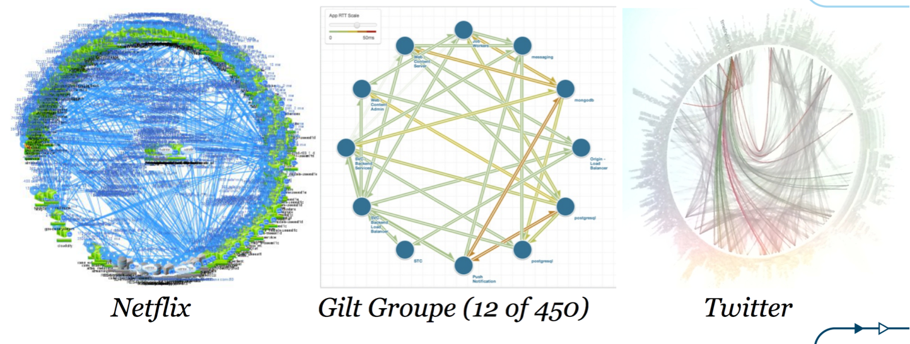
But Microservices!
From: http://www.slideshare.net/adriancockcroft/goto-berlin
Notes:
A graph
one which reveals the true nature of things
and yet this architecture of revealed complexity is at the heart of the fastest moving, most innovative companies in the industry

Slide 17





Microservice Architecture
Relational
DB
HTTP
HTTP
Key/Value
Store
HTTP
HTTP
HTTP
…
AMQP
AMQP
HTTP
Graph
DB
Notes:
REST and message-driven services
Polyglot persistence, services encapsulate data store semantics
Diversity of clients acknowledged
API Gateway for service aggregation, reduce chattiness, protocol translation, reduce latency/round-trips, deal with mobile device fragmentation, build use case/device specific API’s

Slide 18
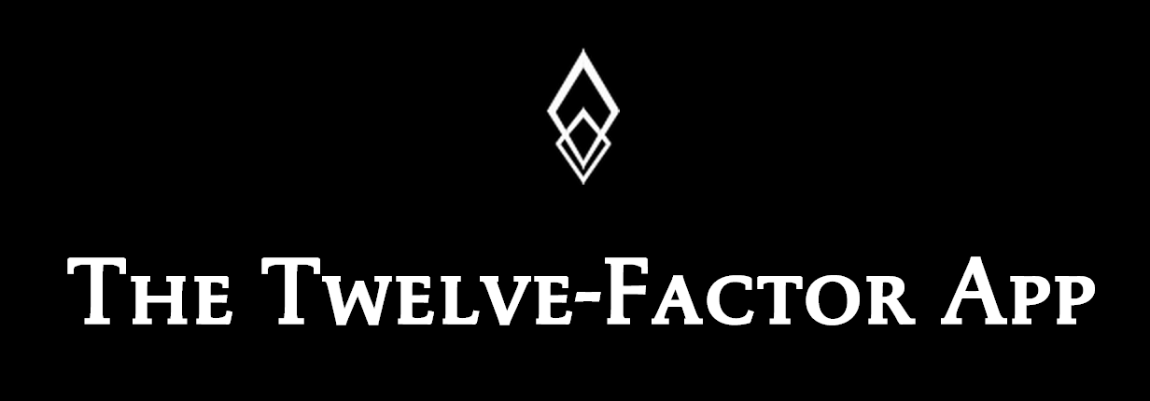
http://12factor.net/

Slide 19
Challenges of Distributed Systems
Configuration Management
Service Registration & Discovery
Routing & Load Balancing
Fault Tolerance (Circuit Breakers)
Monitoring
Concurrent API Aggregation & Transformation
Notes:
Everybody faces these, SCS takes PCF to the next level

Slide 20
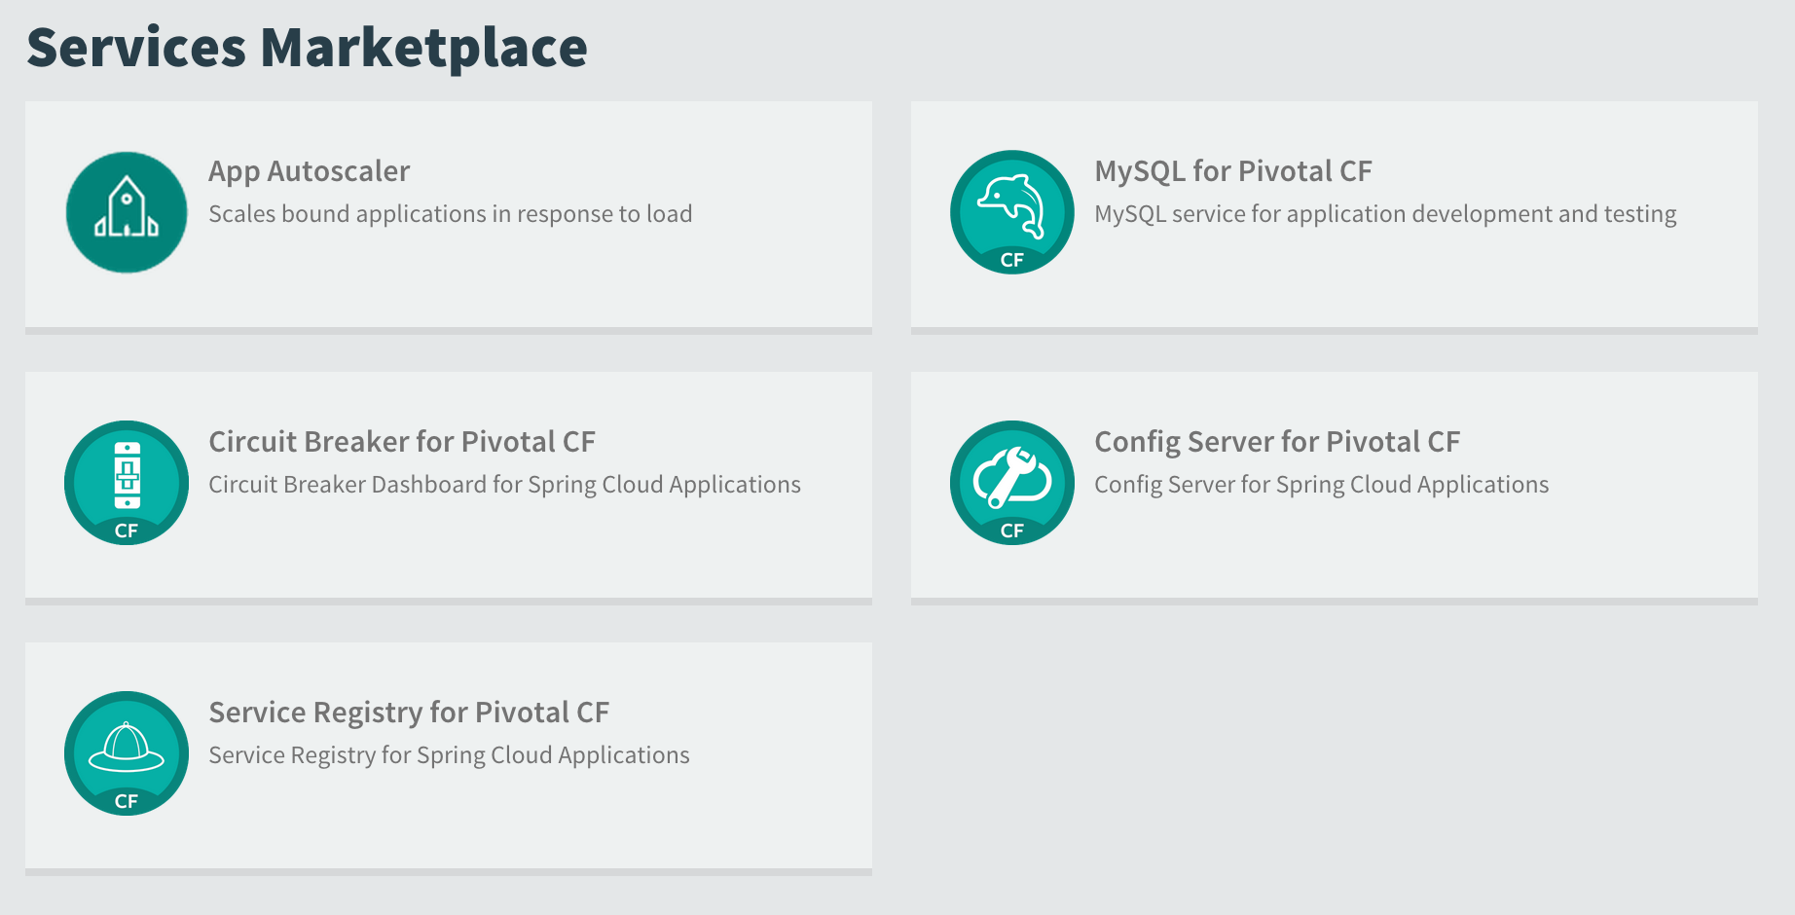


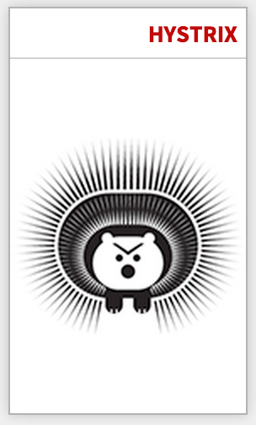

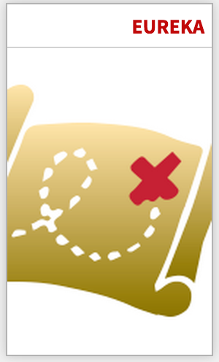



μServices
with
In-App Support Libraries
Bindable Services

Slide 21


Self-Service Agile Infrastructure
Platform
Services
Notes:
While microservices are simple, they are certainly not easy [1]. It's recently been said that "microservices are not a free lunch" [2]. Interestingly enough, if you look at the concerns expressed here about microservices, you'll find that they are *exactly* the challenges that a PaaS is intended to address. So while microservices do not necessarily imply cloud (and vice versa), there is in fact a symbiotic relationship between the two, with each approach somehow compensating for the limitations of the other, much like the practices of eXtreme Programming do the same [3].

Slide 22
What does
the journey look like?

Slide 23

What is Continuous Delivery?
Development
Business
Operations
Customer
$
QA
Notes:
Driven from Lean -> Concept to Cash
Taichi Ohno - reducing the timeline by removing the non-value added wastes
SHRINK <Transition>

Slide 24
What is Continuous Delivery?
$
Notes:
So how do you do that?
By making the first task on any software effort “delivery” - deploy the code somewhere, even if it doesn’t do anything. You might call this a walking skeleton.
And then keep doing that every time you change anything…which primes the pump for real iterative feedback cycles

Slide 25
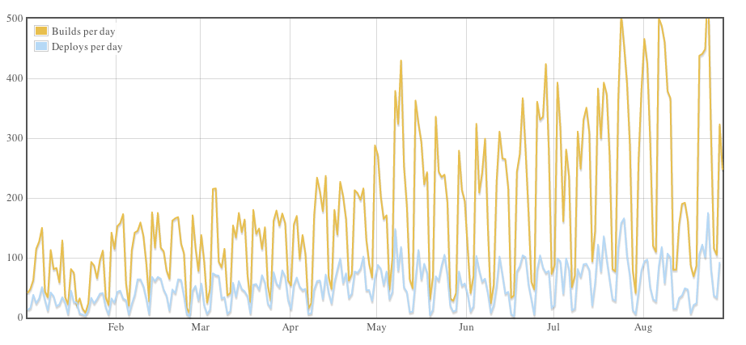
Continuous Deployment?
Github: On August 23, 2012 – 563 builds and 175 deploys

Slide 26
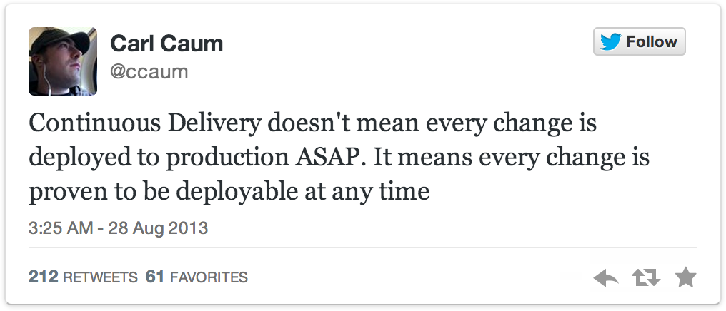
Continuous Delivery != Continuous Deployment
Notes:
So how do you do that?
By making the first task on any software effort “delivery” - deploy the code somewhere, even if it doesn’t do anything. You might call this a walking skeleton.
And then keep doing that every time you change anything…which primes the pump for real iterative feedback cycles

Slide 27



Keep the Wheel Spinning!
Customer
Feedback
Design
Develop
Test
Customer
Delivery
Analytics
Notes:
We don’t just demo to the customer but we actually deliver to the customer - in production
Push out the iteration cycle from a stories to demo cycle to a stories to production deployment cycle
Gain real feedback from real customers: what they say as well as how they behave (analytics)
And ultimately deliver the most value by ensuring that we’re actually building the right thing

Slide 28

Prod
Release
#1
Prod
Release
#2
Waterfall
Organization!
Agile Development
Prod
Release
#3
Notes:
frustrating bit - when we try to do this within that water-scrum-fall type organization that Sam mentioned this morning
we batch up multiple iterations
business is not seeing a steady stream of value
development isn’t getting the benefit of continual course correction

Slide 29





Silo Delivery
Project Mgmt
UX
Dev
QA
DBA
Sys
Admin
Net
Admin
Storage
Admin
MONOLITHIC DELIVERY
Adapted from: http://www.slideshare.net/adriancockcroft/goto-berlin
Notes:
- development process may be agile “per se” - but we then enter traditional ticket-based systems and release cycles for changes to the supporting environment <TRIGGER>
silos protect their turf and optimize locally - making desired project actions — database schema changes, manual regression cycles, environment provisioning — difficult or impossible
- one of the reasons is this batching up of change increasing the perceived risks of delivery from each of the silos, so the knee jerk reaction is to prevent change because change breaks things…and the iterative cycle gets progressively slower and eventually stops.

Slide 30
Continuous Delivery
Product
Mgr
UX
Dev
QA
DBA
Sys
Admin
Net
Admin
Storage
Admin
BUSINESS CAPABILITY TEAMS
USING MICROSERVICES
PLATFORM OPERATIONS TEAM
Adapted from: http://www.slideshare.net/adriancockcroft/goto-berlin
Notes:
shift from PROJECTS to PRODUCTS
cross functional business capability teams — all roles necessary to build, test, deliver, operate services delivering that business capability — characteristics of microservices tend to right size systems to right sized teams and capabilities
platform operations team - provides self-service agile infrastructure to business capability teams - or the business capability of a fabric on which to deliver other business capabilities - that cloud-native application platform

Slide 31
Continuous Delivery
Product
Mgr
UX
Dev
QA
DBA
Sys
Admin
Net
Admin
Storage
Admin
Self
Service
API
BUSINESS CAPABILITY TEAMS
USING MICROSERVICES
PLATFORM OPERATIONS TEAM
Adapted from: http://www.slideshare.net/adriancockcroft/goto-berlin
Notes:
business capability teams consume the platform via self-service API’s
just as microservices communicate w/ each other via API’s, so does the microservice with its hosting platform

Slide 32
CATALOG
INVENTORY
Prod Release
Prod Release
Prod Release
Prod Release
Prod Release
Prod Release
REVIEWS
SHIPPING
Prod Release
Prod Release
Prod Release
Prod Release
Prod Release
Prod Release
Notes:
- leads to autonomous business capability teams that complete the entire concept to cash release cycle
teams are continuously deliver value around their capabilities, moving in an agile manner, responding to changes in the business, moving swiftly
able to form new teams specifically to innovate and experiment with new business models and ideas

Slide 33
Where do I start?

Slide 34

A little cloud book…
Available to you
compliments of Pivotal!
Get your FREE print copy
at the O’Reilly booth!
Or, get the FREE e-book
at http://bit.ly/cloud-native-book!

Slide 35
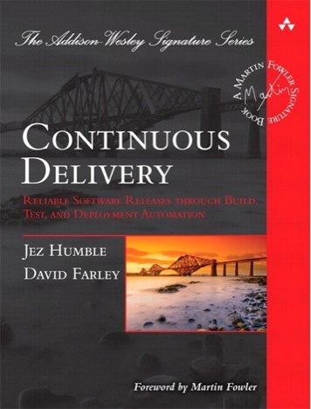
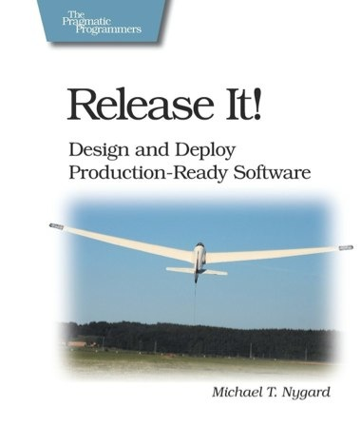
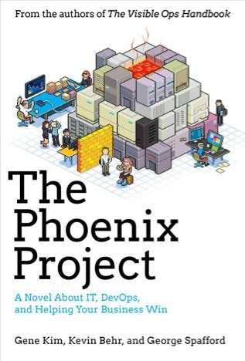
Foundations
Notes:
continuous integration of development changes
one package / many deploys
automation
deploy smaller batches more frequently
automate all testing where test failures would prevent prod release

Slide 36
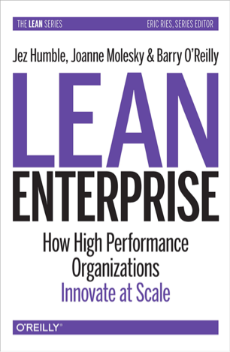

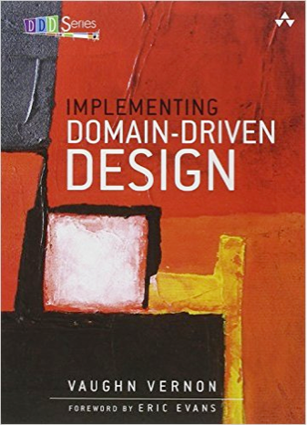
Foundations
Notes:
continuous integration of development changes
one package / many deploys
automation
deploy smaller batches more frequently
automate all testing where test failures would prevent prod release

Slide 37
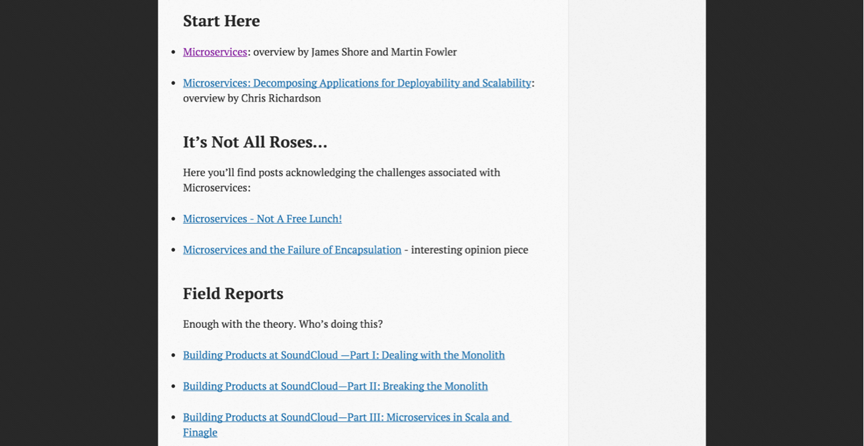
http://www.mattstine.com/microservices

Slide 38
Show me some code…
https://github.com/spring-cloud-samples/fortune-teller
https://github.com/spring-cloud-samples/springbox-cloud

Slide 39

https://2015.event.springone2gx.com/register

